Slide 1

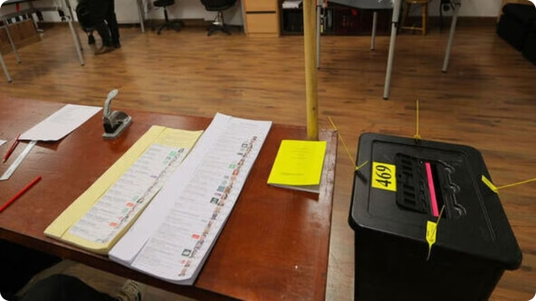
Election 2024 Data Analysis

Slide 2
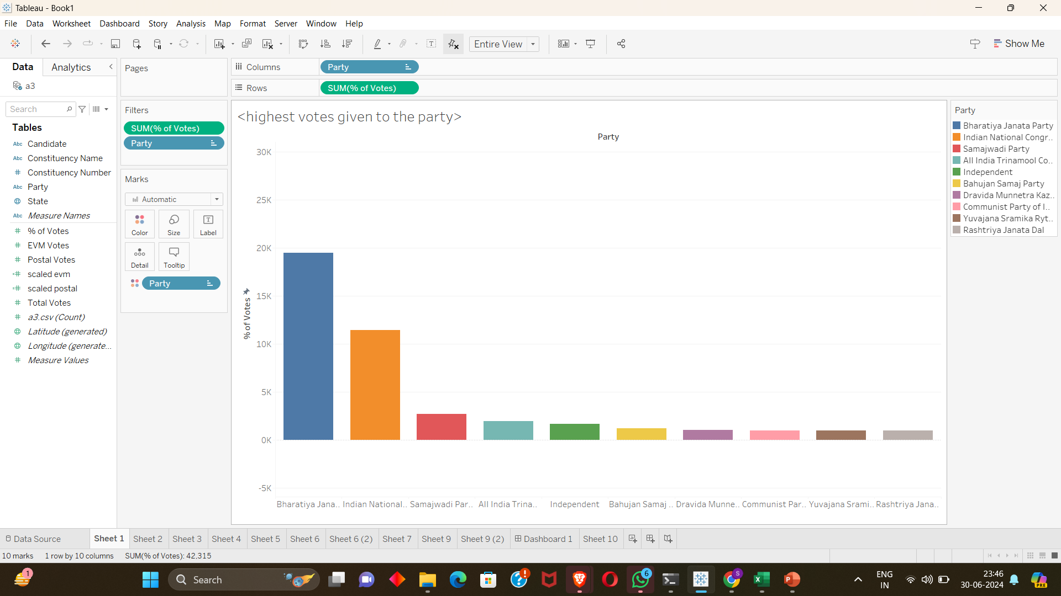
Highest Votes Of Top 10 Party
This is the distribution of the votes to each party in descending order

Slide 3
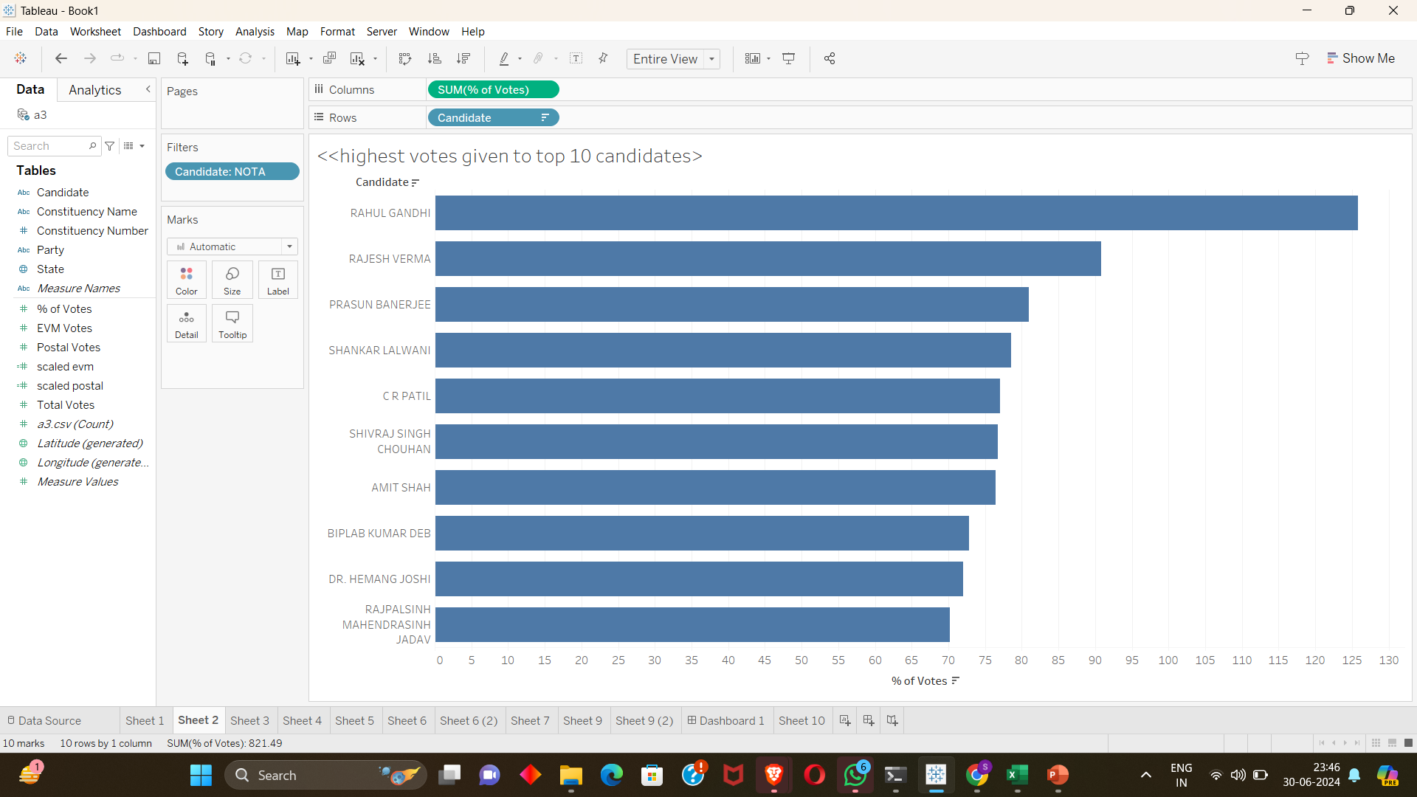
Highest Votes Of Top 10 Candidates
This is distribution of votes to each candidate in descending order

Slide 4
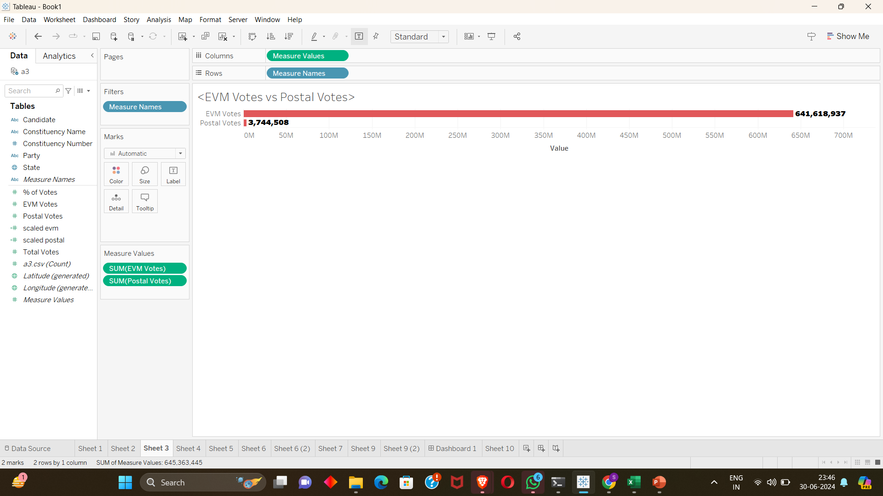
EVM Votes VS Postal Votes
This is the comparison of EVM votes and the Postal votes ,as the areas where voting booths cannot be installed will undergo the postal votes.

Slide 5
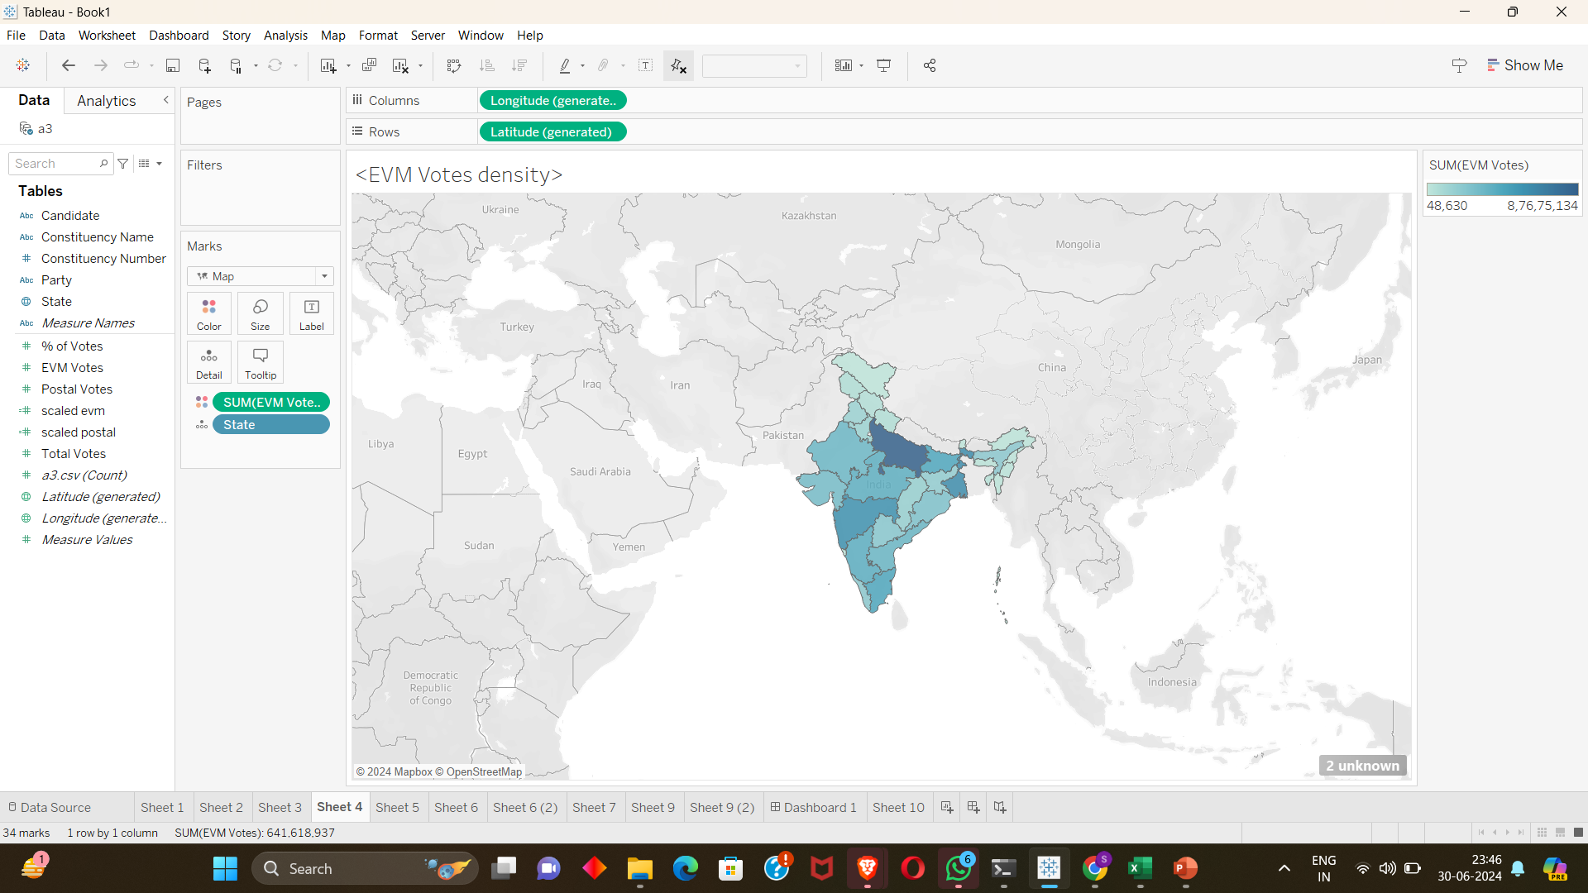
EVM Votes Density
The density at which the EVM votes are given according to the states are represented here the darker region represents the dense, the lighter area represents the sparse

Slide 6
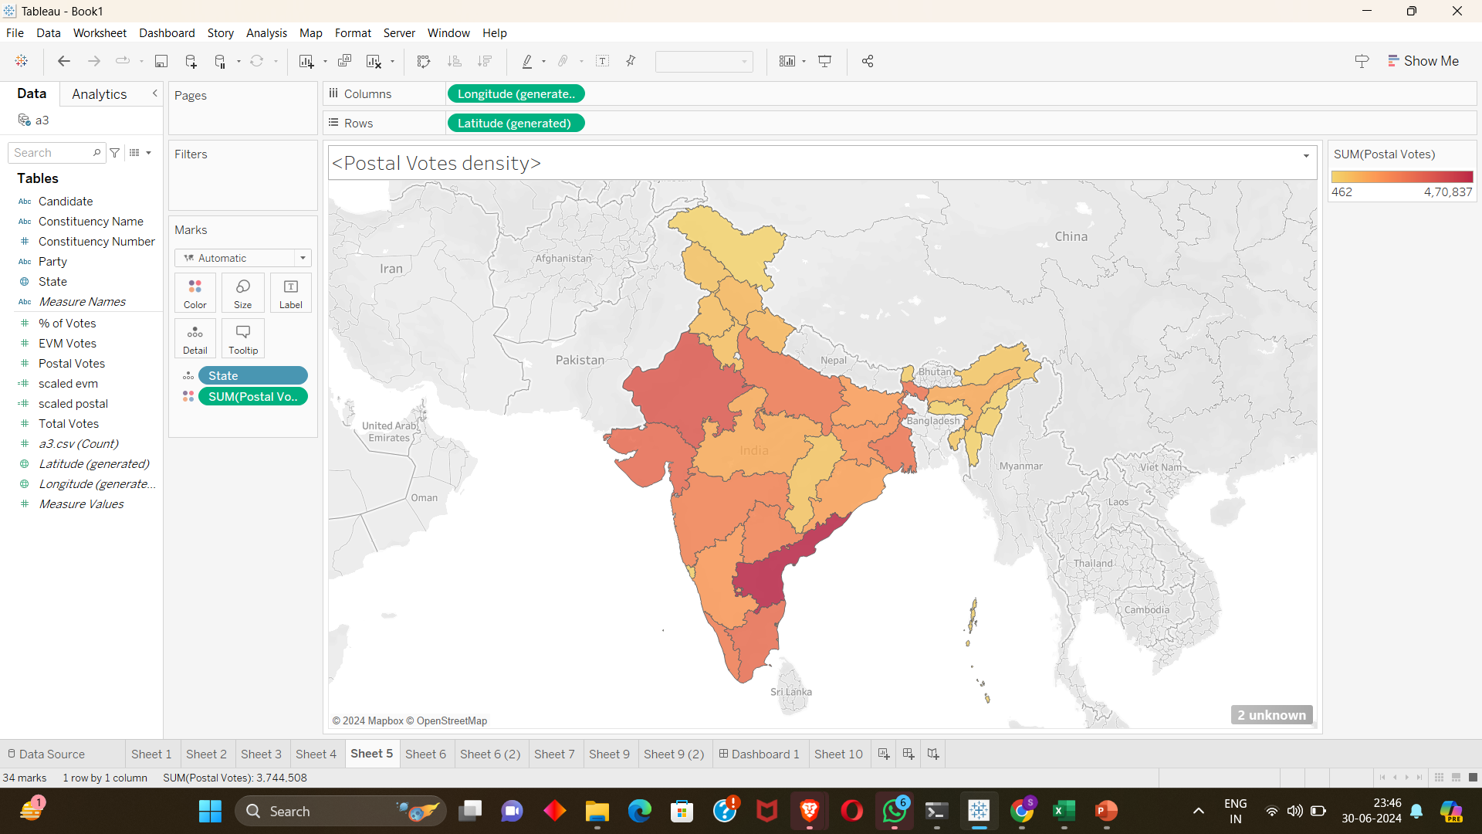
Postal Votes Density
The density at which the Postal votes are given according to the states are represented here the darker region represents the dense, the lighter area represents the sparse

Slide 7
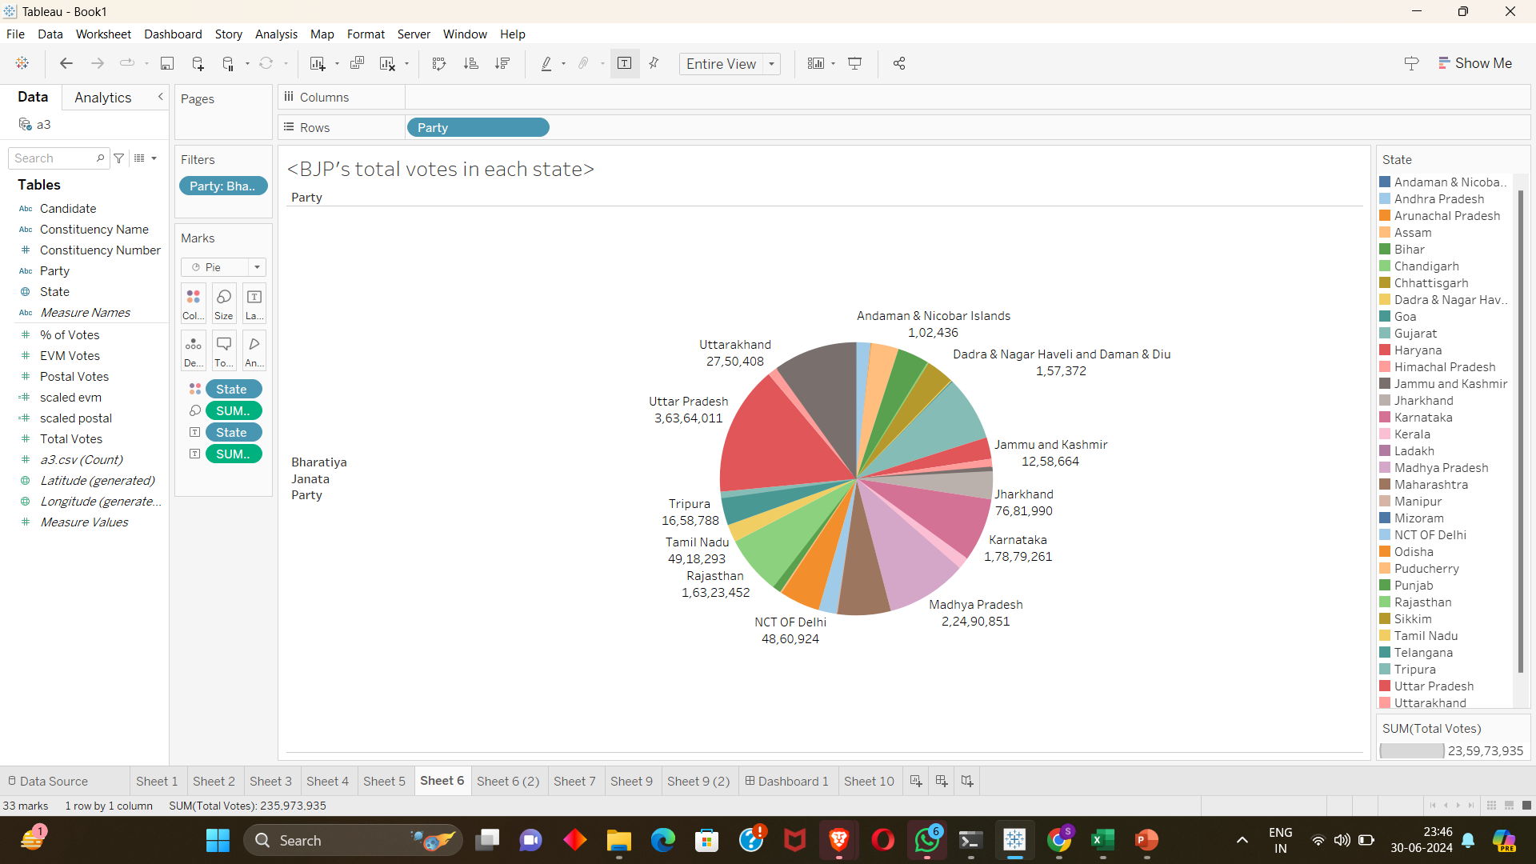
BJP Total Votes In Each State
This represent the total votes BJP has acquired in each states
Combating Misinformation
Efforts to combat disinformation are ongoing, involving collaboration between governments, tech companies, and media organizations.

Slide 8
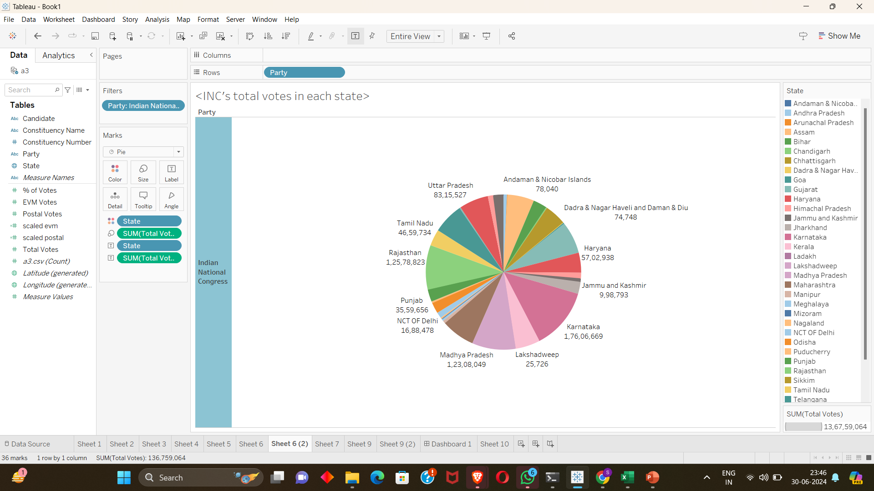
INC’S Total Votes In Each State
This represent the total votes INC has acquired in each states

Slide 9
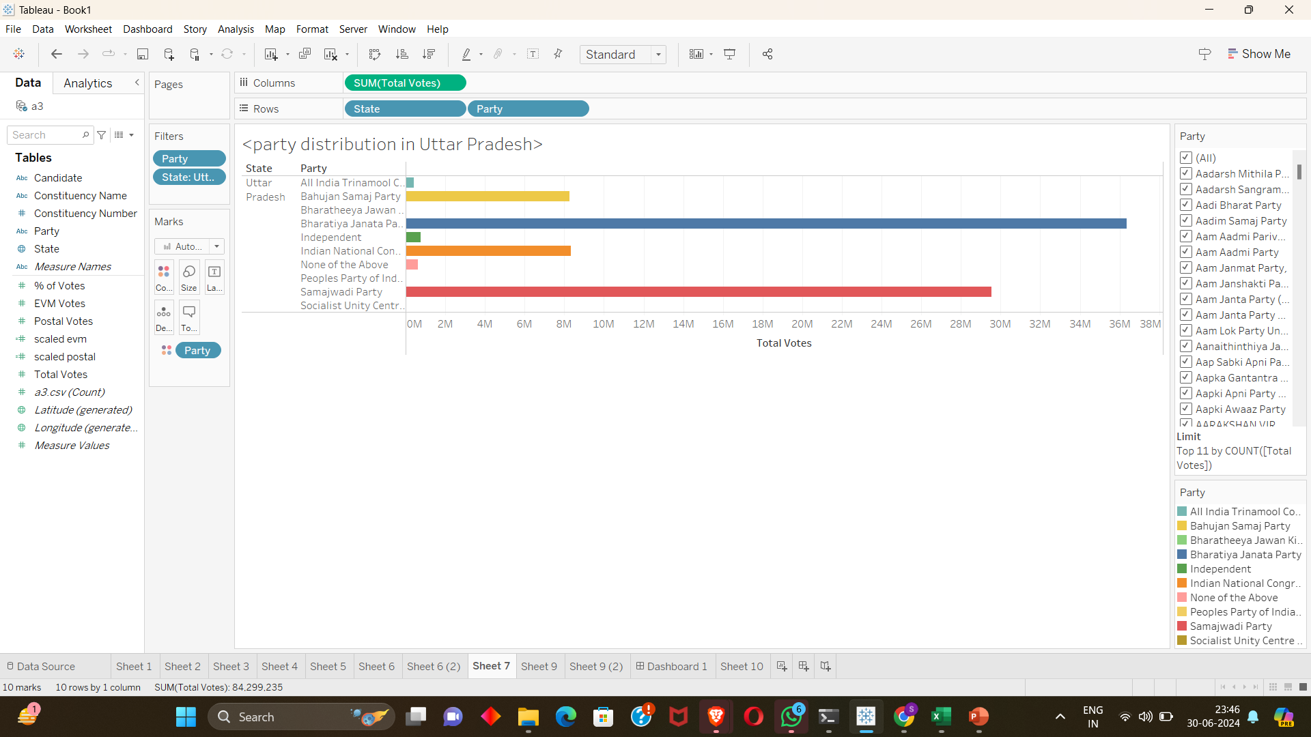
Party Distribution In UP
As UP is the state with the highest no to seats as compared to others, so it was required to give its dense representation.

Slide 10
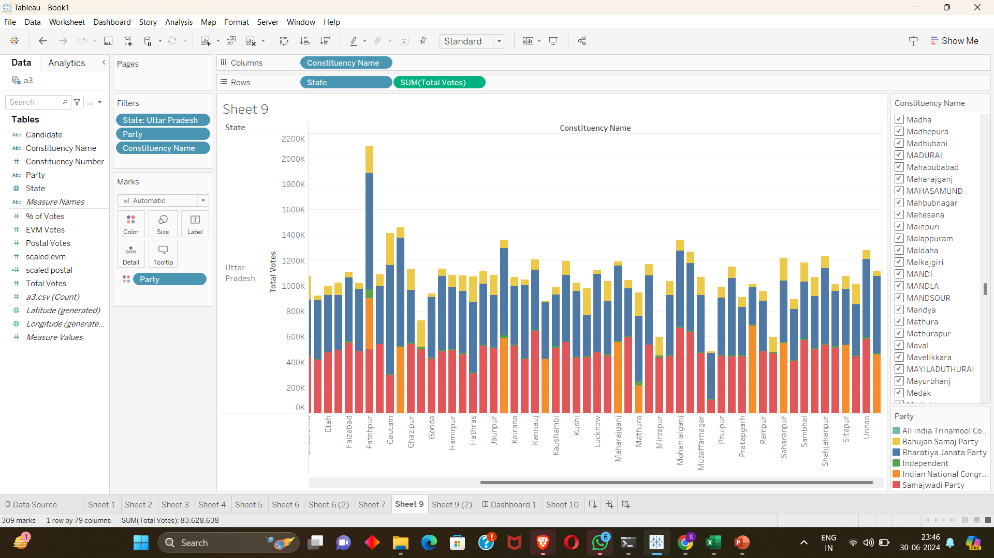
Party Distribution In UP According To Constituency

Slide 11
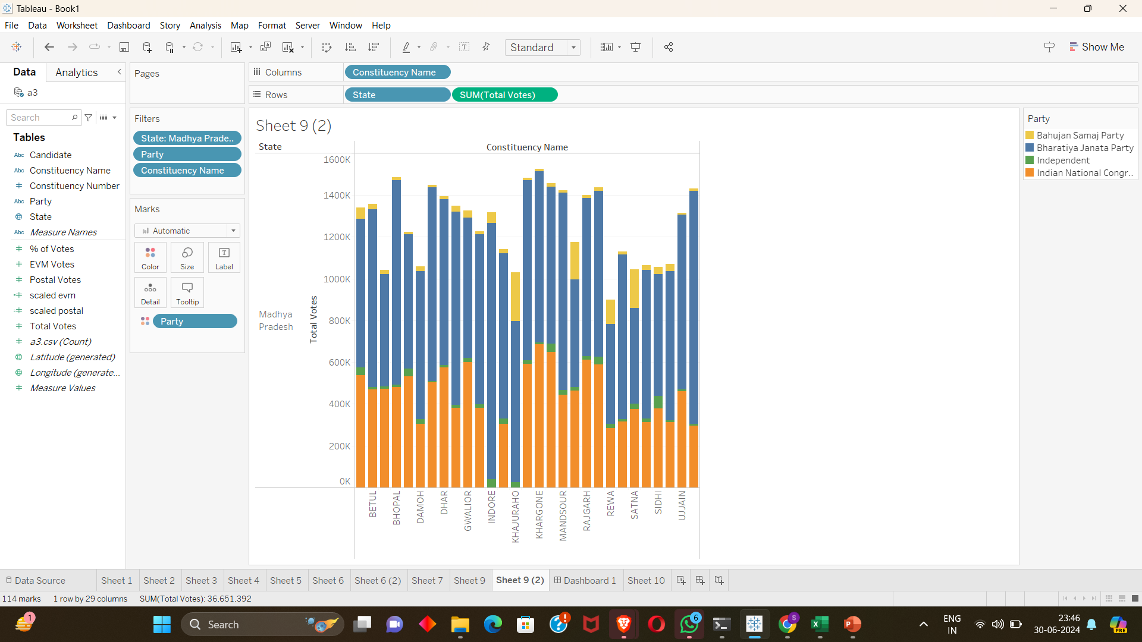
Party Distribution In MP According To Constituency
This is the representation of Madhya Pradesh’s constituency wise.
Here we can see that in Indore there is only BJP as it was because the many voters has voted to NOTA

Slide 12
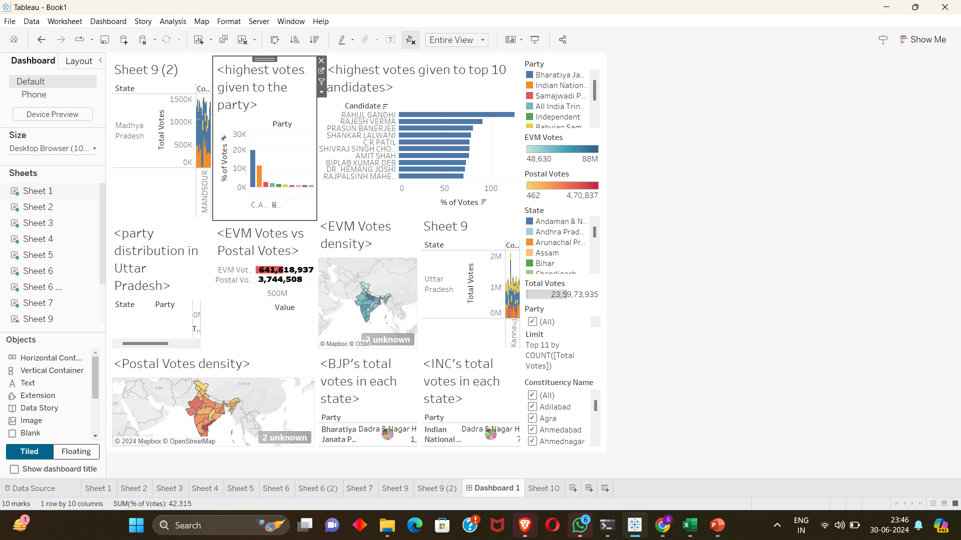
All In One Dashboard

